Slide 1
用户账户简介

Slide 2
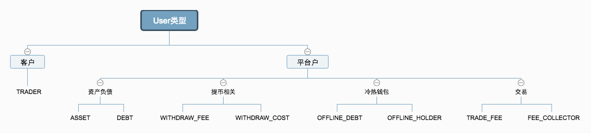
用户类型

Slide 3
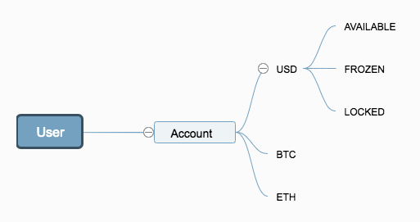
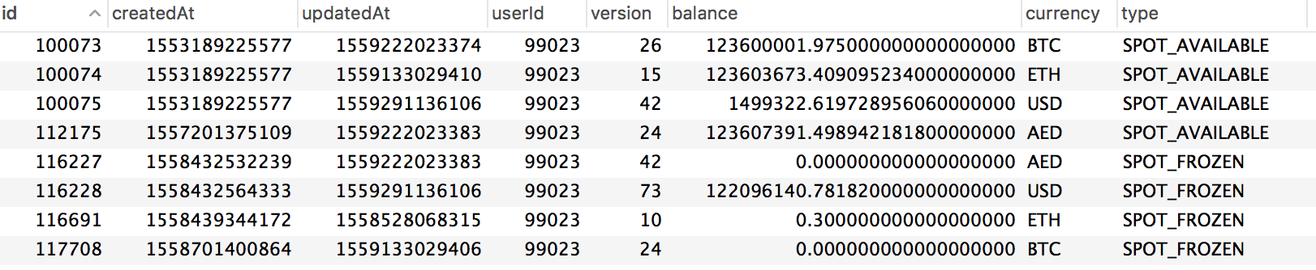
用户-账户关系

Slide 4
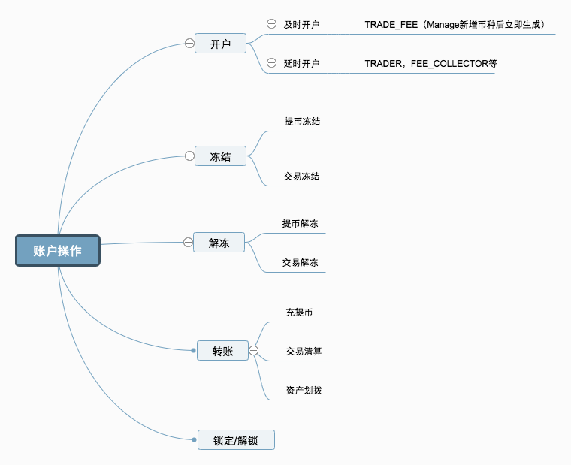
账户操作

Slide 5
充提币账户资金流
 | DEPOSIT |  |  |  | Withdraw
ASSET | 0 | 10 | 0 |  | 0 | 7 | 0
DEBT | 0 | -10 | -10 |  | -10 | -10 | -3 | -2.5
USER X | 0 | 0 | 10 |  | 2 7+1 | 2 | 2 | 2
WITHDRAW_FEE | 0 | 0 | 0 |  | 0 | 1 | 1 | 1
WITHDRAW_COST | 0 | 0 | 0 |  | 0 | 0 | 0 | -0.5
DEPOSIT:
WITHDRAW:

Slide 6
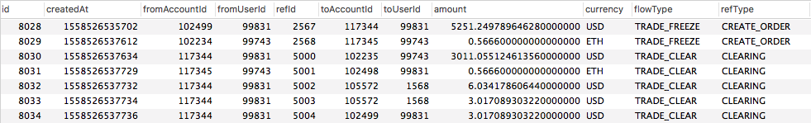
交易账户资金流
BTC_ETH，手续费各收1ETH
 |  | 交易清算
Taker | BTC | 0 | 0 | 1 | 1
 | ETH | 2000 | 1499 501 | 1499 2 | 1499 0
Maker | BTC | 5 | 4 1 | 4 | 4
 | ETH | 0 | 0 | 499 | 499
TRADE_FEE | ETH | 0 | 0 | 0 | 2

Slide 7
交易手续费归集账户资金流
TRADE_FEE_1 | 10 | 10
TRADE_FEE_2 | 20 | 20
TRADE_FEE_3 | 30 | -30
FEE_COLLECTOR | 0 | 60

Slide 8
Thanks

